Slide 1
MULTIPLE REGRESSION ANALYSIS
This model can be applied for more than two variables. Here, Y, X2 and X3 are the variable parameters to be analyzed. (There is a relationship between Y and other parameters X2,X3)
For three variables;
Y=β₁ + β₂ X₂ + β₃ X₃ + ε
For n-th variables;
Y=β₁ + β₂ X₂ + β₃ X₃ +...+ β_{k} X_{k} + ε
.

Slide 2
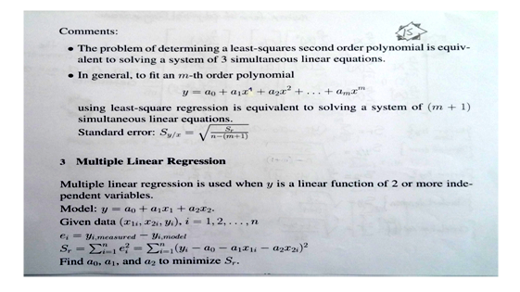

Slide 3
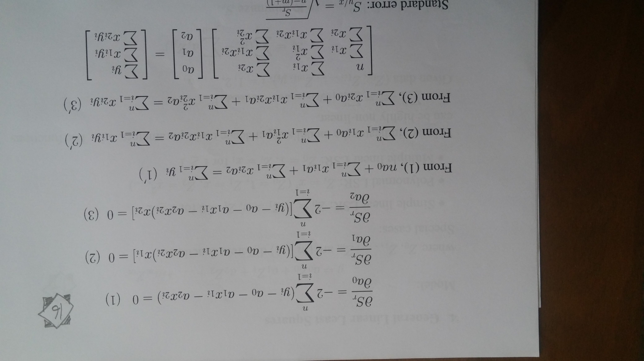
Standart Error Sy/x= [Sr/(n-(m+1))]^{1/2}
Notes:
n-(m+1)

Slide 4
EXAMPLE: Y=Cotton production X2=Price X3=income What is the multiple regression coefficient and standart devation?
Y
X2
X3
59.20
65.40
62.30
64.70
67.40
64.40
68.00
73.40
75.70
70.70
76.2
91.7
106.7
111.6
119.0
129.2
143.4
159.6
180.00
193.0
23.50
24.40
32.10
32.40
31.10
34.10
35.30
38.70
39.60
46.70

Slide 5
ΣY=? , n , k=3, ΣX₂=? , ΣX₃=? ΣYX₂= ? , ΣYX₃= ?, ΣX₂X₃= ? ΣX₂²=? , ΣX₃²=?

Slide 6
Y
X₂
X₃
YX₂
YX₃
59.20
65.40
62.30
64.70
67.40
64.40
68.00
73.40
75.70
70.70
76.2
91.7
106.7
111.6
119.0
129.2
143.4
159.6
180.0
193.0
23.50
24.40
32.10
32.40
31.10
34.10
35.30
38.70
39.60
46.70
4511.04
5997.18
6647.41
7220.52
8020.60
8320.48
9751.20
11714.6
13626.0
13645.1
1391.20
1595.76
1999.83
2096.28
2096.14
2196.04
2400.40
2840.58
2997.72
3301.69
ΣY=671.20
ΣX₂=1310.40
ΣX₃=337.90
ΣYX₂=89454.17
ΣYX₂=22915.64

Slide 7
X₂X₃
X₂²
X₃²
1790.70
2237.48
3425.07
3615.84
3700.90
4405.72
5062.02
6176.52
7128.00
9013.10
5806.44
8408.89
11384.89
12454.56
14161.00
16692.64
20563.56
25472.16
32400.00
37249.00
552.2
595.3
1030.41
1049.76
967.2
1162.81
1246.09
1497.69
1568.16
2180.89
ΣX₂X₃=46555.35
ΣX₂²=184593.14
ΣX₃²=22915.64

Slide 9
-131.04/

Slide 10
-33.79/

Slide 11
-5.26 /

Slide 14
Price
Income
Cotton product

Slide 15
Checking the multiple regression equation
For X₂₀ = 140 and X₃₀ = 38

Slide 16
Standart deviation

Slide 17
Standart Deviation
Cotton
Y
Price
X₂
Income
X₃
e
e²
59.20
65.40
62.30
64.70
67.40
64.40
68.00
73.40
75.70
70.70
76.2
91.7
106.7
111.6
119.0
129.2
143.4
159.6
180.0
193.0
23.50
24.40
32.10
32.40
31.10
34.10
35.30
38.70
39.60
46.70
61.30455
64.91151
61.72264
62.84776
66.26159
66.28019
69.21737
70.58173
75.60724
72.42623
-2.10
0.49
0.58
1.85
1.14
-1.88
-1.22
2.82
0.09
-1.73
4.429131
0.238622
0.333345
3.430793
1.295977
3.535114
1.48199
7.942646
0.008604
2.97987
ΣY=671.20
Σe = 0.04≅0
Σe² = 25.68

Slide 18
Standart Deviaton (s) and Multiple Regression Coefficient R2
=1.9154
= 0.8879 ≅ 0.89

Slide 19
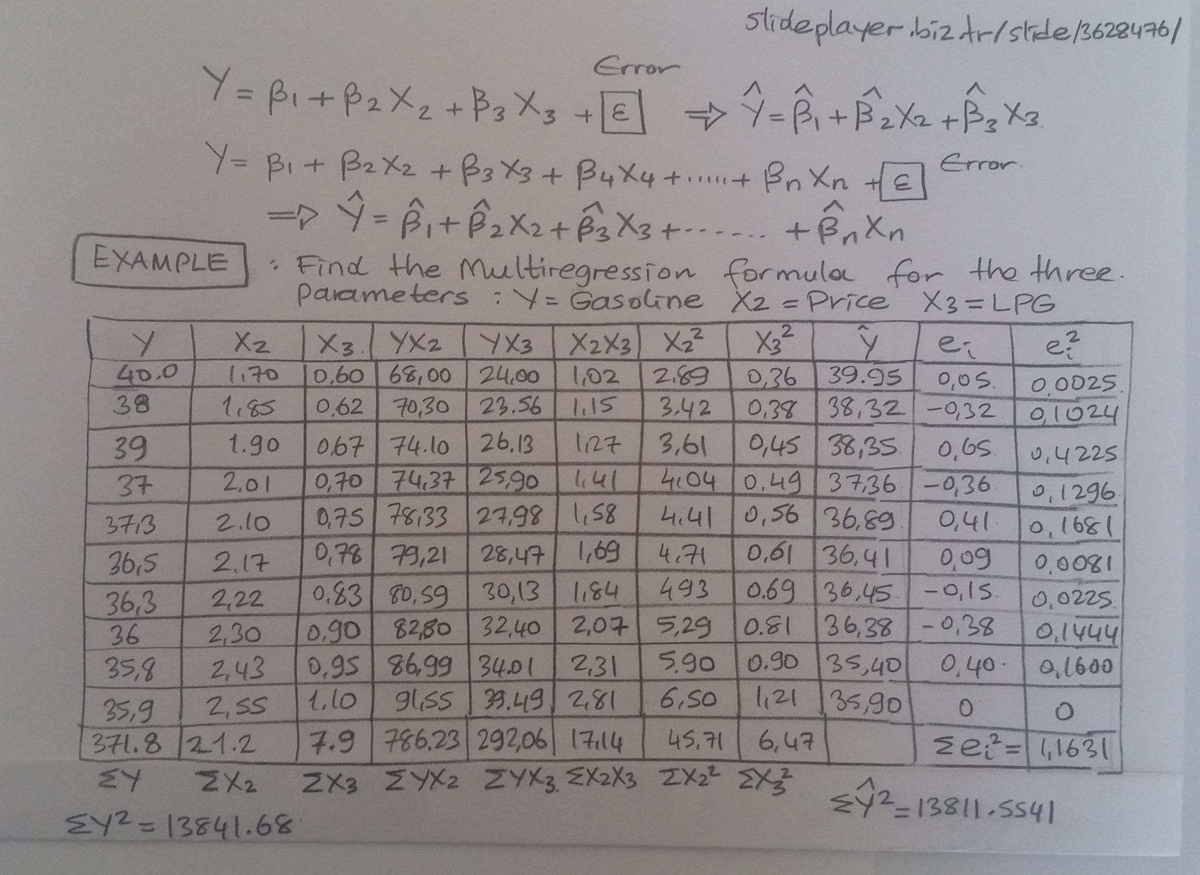

Slide 20
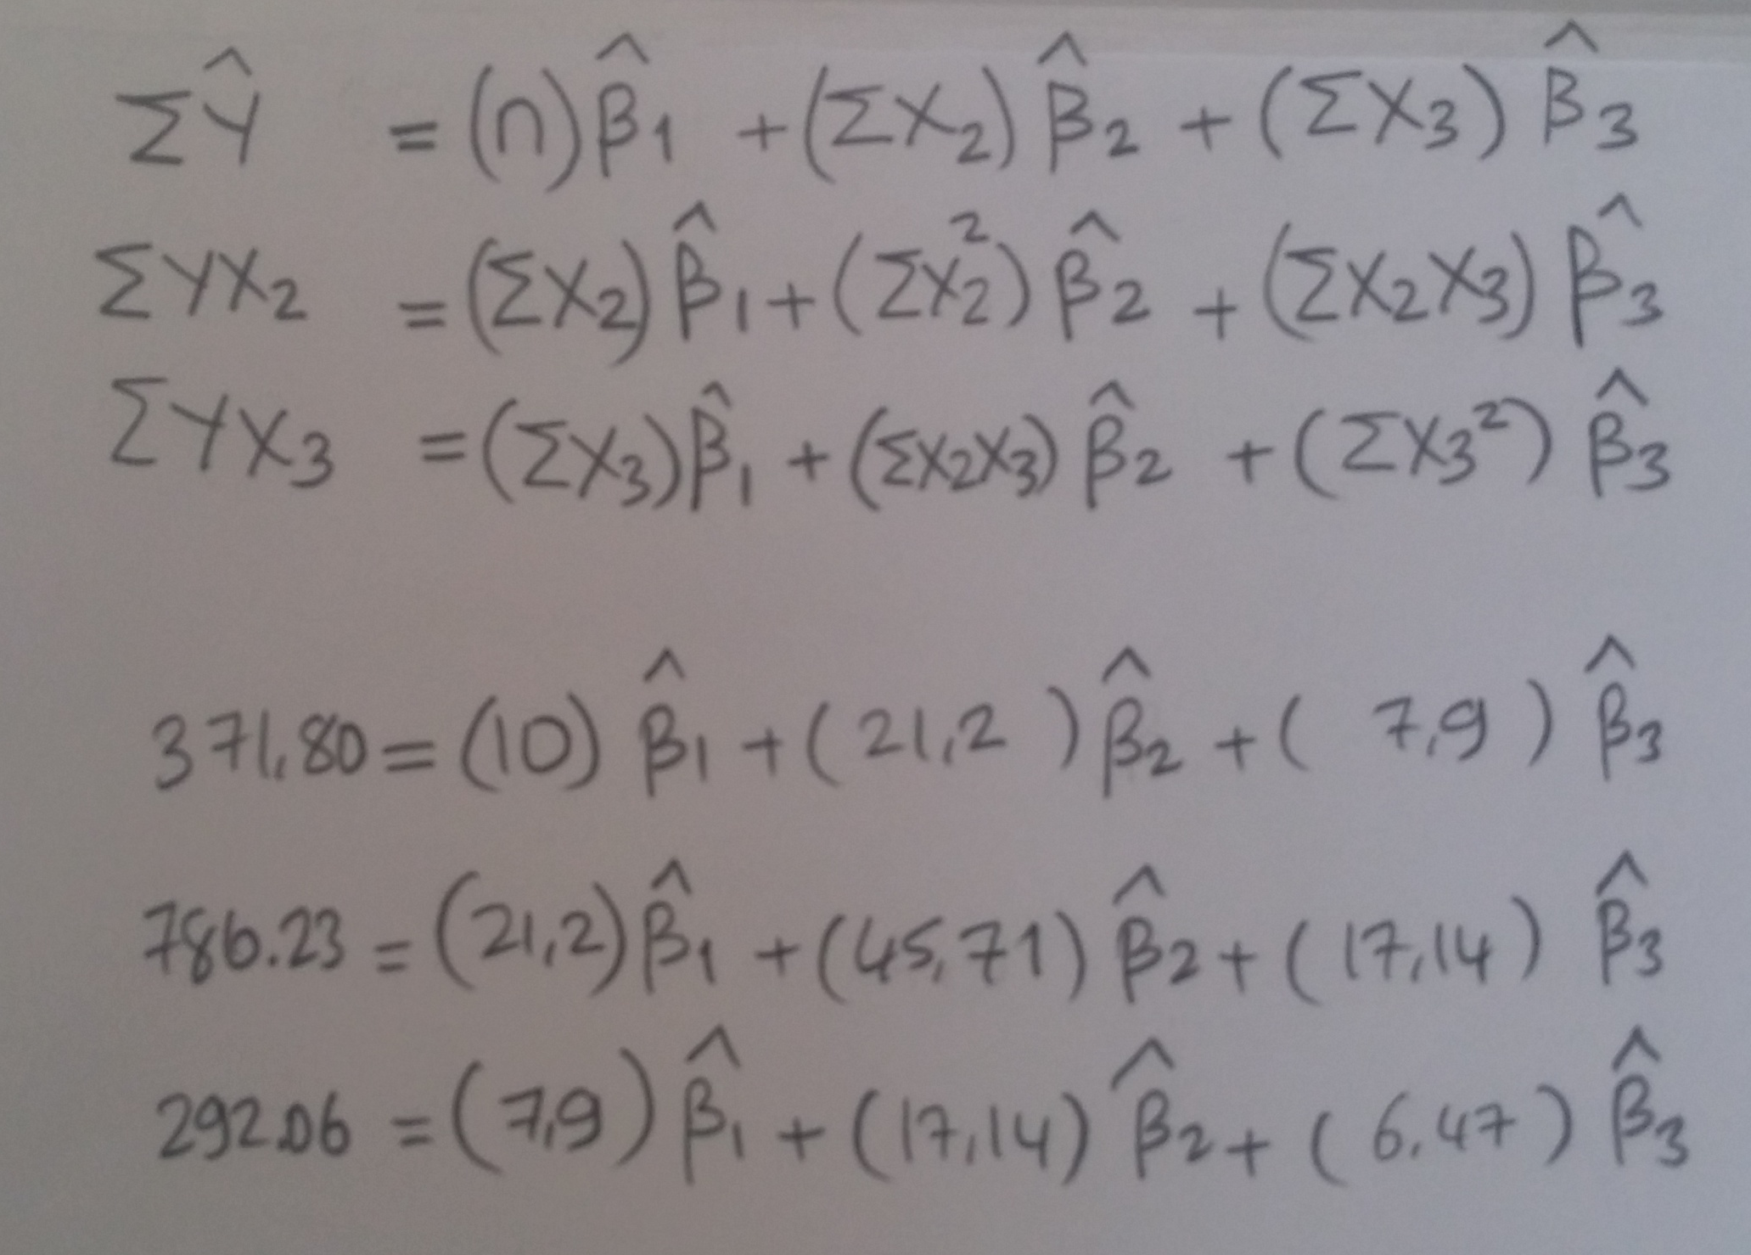

Slide 21
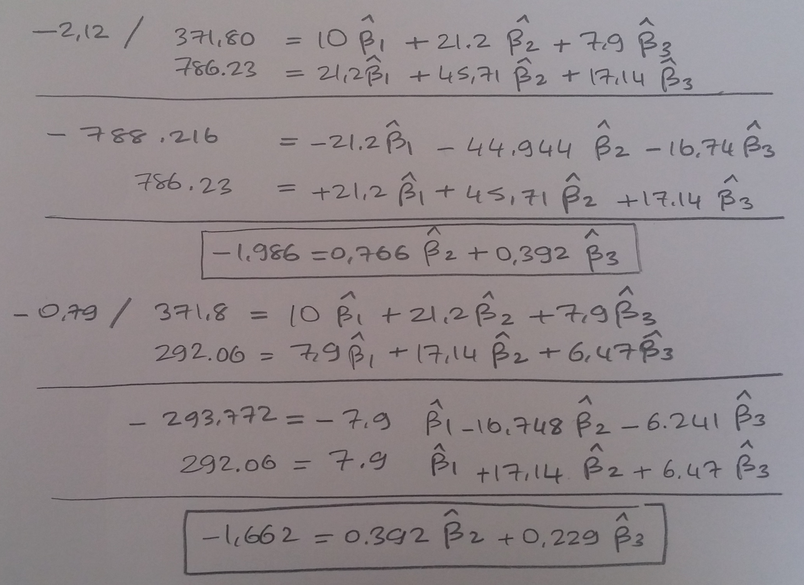

Slide 22
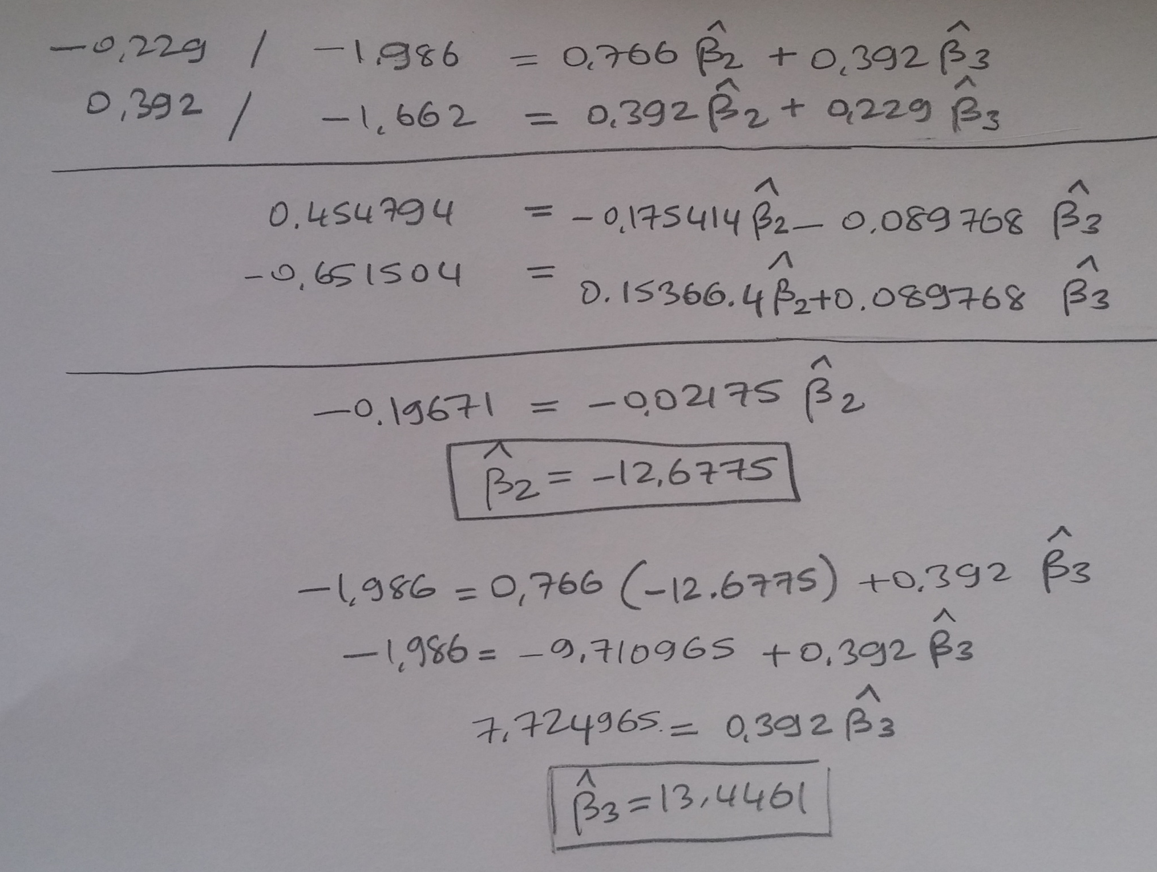

Slide 23
